Slide 1

YOGA HAPPENS BEYOND THE MAT AS WELL
attention
to how you feel is doing Yoga”
“Anything you do with
Join Yoga classes at ‘YoGa Studio’
For more visit www.yogastudio.com

Slide 2
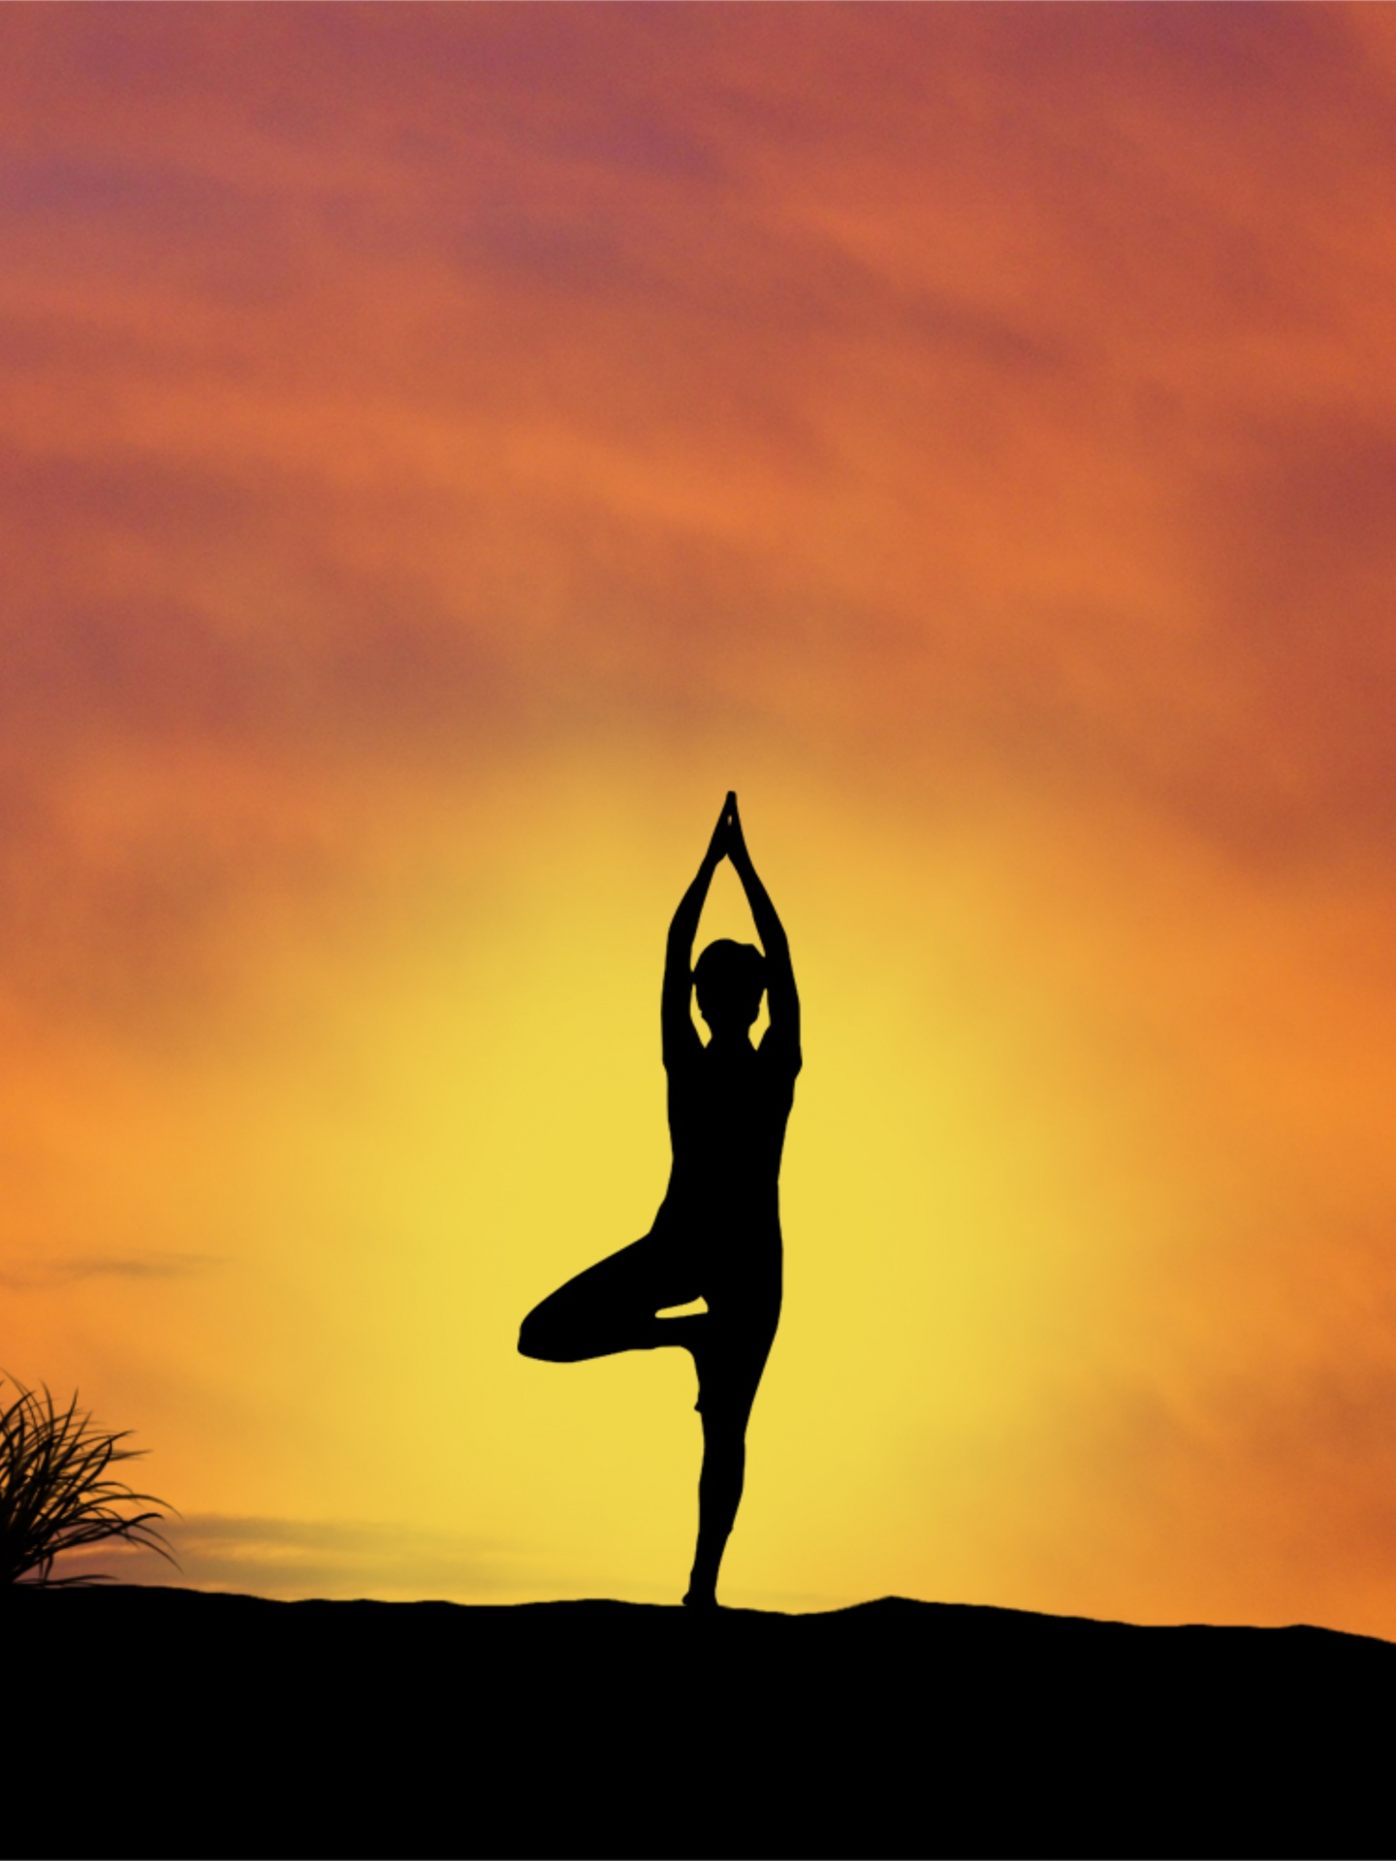
THE TIME TO RELAX IS WHEN YOU DON’T HAVE TIME FOR IT
“Make some time for yourself
Join Yoga classes at ‘YoGa Studio’
For more visit www.yogastudio.com

Slide 3
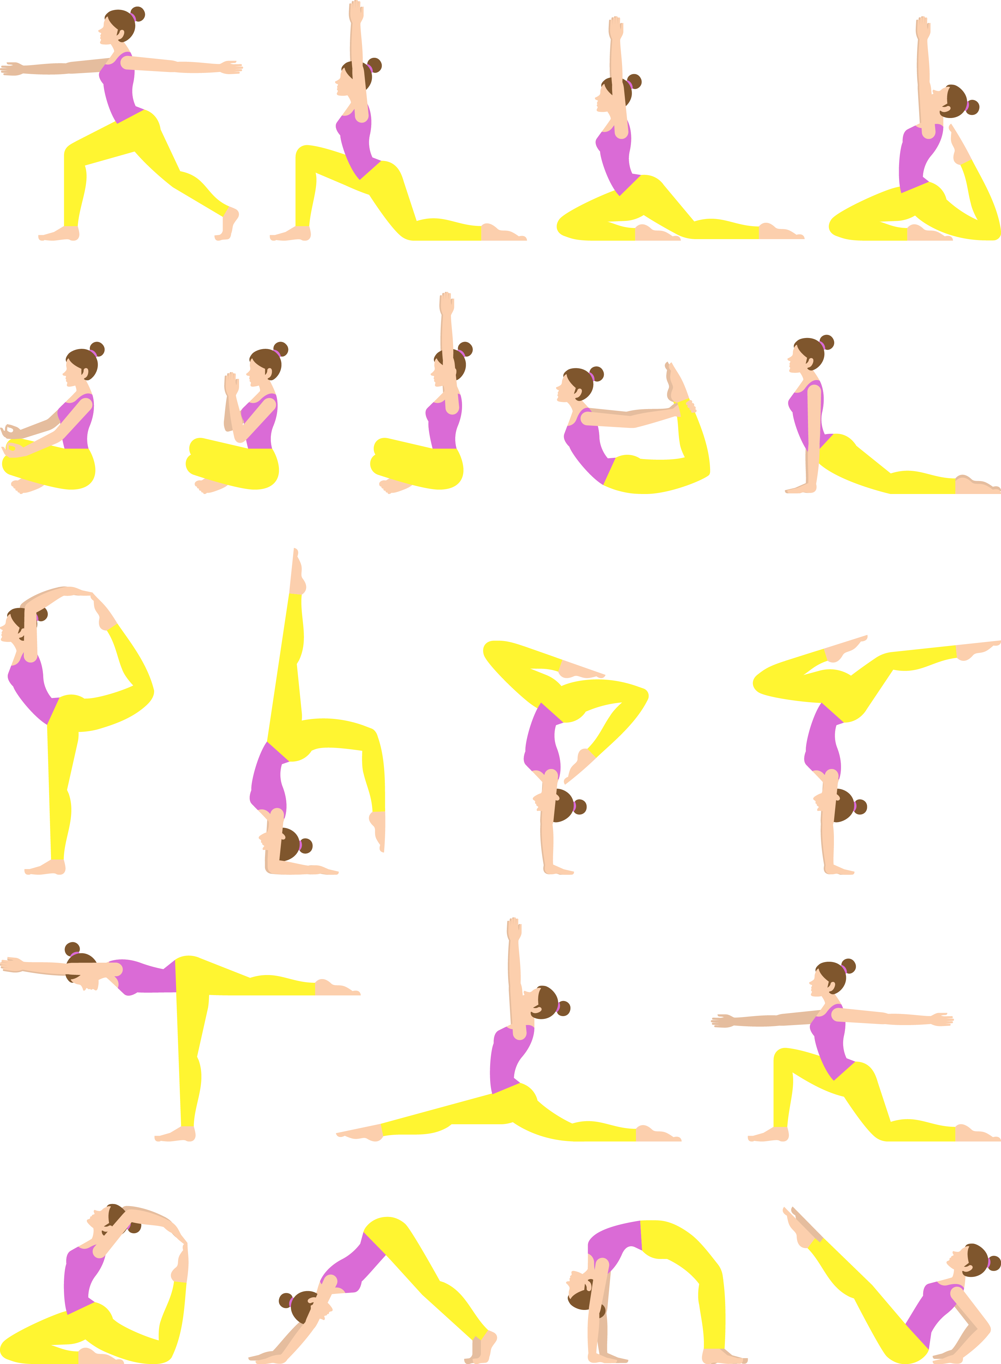
NAMASTE
Asanas that will change your body forever”
Yoga keeps you physically as well as mentally well
Join Yoga classes at ‘YoGa Studio’
For more visit www.yogastudio.com

Slide 4

KEEP CALM AND DO YOGA
Join Yoga classes at ‘YoGa Studio’
For more visit www.yogastudio.com

